Slide 1
Thank you for joining us
Grab yourself a cup of tea and join us for tonight’s meeting of the Cardiff Landlord Forum, starting at 6pm.
Please remember to mute yourself.

Slide 2
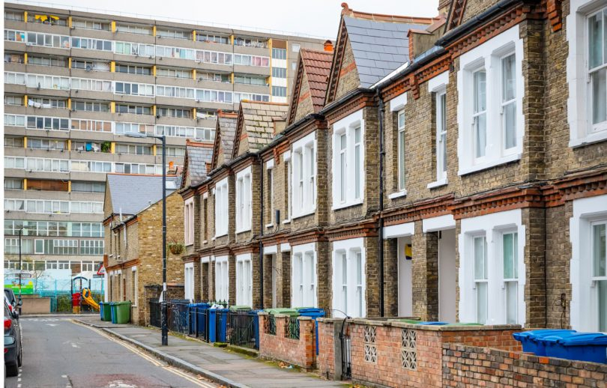
Title slide
Cardiff Landlord Forum
Wednesday 13th January 2021
Douglas Haig, NRLA Director and CLF Chairman
@Douglas_Haig / @NRLAWales
Author

Slide 3
Agenda
Coronavirus
Financial support
Possession
Renting Homes (Amendment) Bill
Local Licensing
NRLA Wales manifesto and research
New NRLA Wales Regional Representative
AOB

Slide 4
Wales Covid Rules
Wales is at Alert Level 4. At alert level 4 you must:
Follow social distancing rules with people you don’t live with or who are not in your support bubble.
Wear a face covering in all indoor public places.
Stay at home and work from home if you can.
Not create an extended household (single adults/parents may join with one household to form an exclusive support bubble).
Meet only the people you live with or your support bubble.
Not travel without reasonable excuse.
What does Alert Level 4 mean for the PRS?
Evictions cannot take place (exceptions inc. ASB)
Home moves can occur if moving date delay until lifting of restrictions. Associated activities (e.g. removals processes, handover of keys, surveys and valuations) can take place in line with guidance on working in other people’s homes.
Home viewings can take place. Virtual viewings should be used wherever possible, but viewings of properties can take place but household mixing must be avoided during viewings.

Slide 5
Coronavirus: Top Tips
Follow government guidance at all times – this is the priority and will help justify any action/inaction.
Contact your council and Rent Smart Wales directly if a problem arises or you want absolute, backed-up clarity for the property area.
Evidence as much as you can your efforts to assist tenants and/or fix property hazards.
Ensure urgent works are carried out and done so safely.
If finances are affected, seek funds from government support, whether this be you or your tenant(s) – that’s what its there for.
Be flexible and understanding with your tenants – negative news stories about landlords will not help at this time.

Slide 6
NRLA Research
Dynata surveyed 2,077 private renters in England & Wales between 17 Nov-9 Dec for the NRLA. 137 (6.6% of sample) from Wales. England & Wales results:
11% of private renters are now unemployed.
91% of private renters have NOT built any arrears since March 2020.
7% have built arrears since March. This would amount to around 840,000 renters across the sector as a whole.
Whilst median rent arrears were £251-500,18% of those in debt had built arrears of over £1,000. Across the sector this would mean just over 150,000 renters.
Renters most likely to have built arrears since March are younger people (14% of 18-24s and 10% of 25-34s) and the self-employed (17%).
4% of all respondents had been served a legal notice that the landlord wishes to take possession of the property they are presently renting for a mixture of reasons, not all necessarily associated with rent arrears.

Slide 7
Support for Tenants
Tenancy Saver Loans – loans to tenants to cover arrears – open until 31 March 21.
Payment goes straight to the landlord/agent; interest of 1% APR with up to five years to pay back; can be back-dated to 1 March 2020.
Currently no cap on the amount that can be borrowed and no end date – but £8m pot.
If tenant already on benefits, they should go to council and get DHP instead of loan
Will not link this to landlord evicting their tenant, but hope/expect landlords to ensure tenant utilises loan to avoid this
https://gov.wales/scheme-help-tenants-affected-coronavirus-launches-wales
PRS Helpline
For tenants struggling with rent, income, or housing benefits. Funded by the Welsh Government – run by Citizens Advice Cymru.
A free, confidential, independent service that will advise tenants on ways in which they can maximise their income and manage debt – with a view to helping them pay their rent if they can and hold on to their tenancies.
The number is 0300 3302177 – open Monday-Friday from 9:00-17:00.

Slide 8
Extension of Evictions Ban
Welsh Government announced that the suspension on eviction enforcement – due to end on 11 January – will be extended to the end of March 2021.
However, it could end earlier as the Welsh Government will review this every three weeks.
Suspension does not stop possession proceedings continuing through the courts, but it does prevent bailiff enforcement action.
Follows UK Government’s extension of the ban by six weeks in England.
Exemptions to the suspension of repossession actions inc. ASB.
Different exemptions in England and Wales.
Wales not followed England in making one of the exemptions to the ban those with arrears in excess of six months. Reflects Tenancy Saver Loan in Wales and the absence of such a support scheme in England.

Slide 9
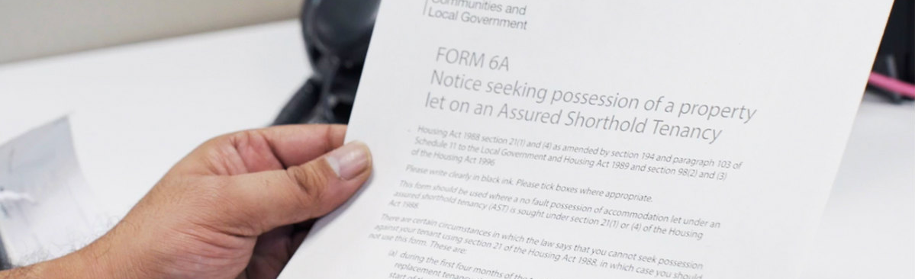
Changes to Possession: Reminder
26 March-23 July: all notices three months
24 July 2020-31 March 2021: all notices six months (but ASB & DV still three)
29 September-onwards: ASB and DV return to pre-pandemic lengths (Section 8, Grounds 7A and 14).
gov.wales/coronavirus-covid-19-guidance-for-landlords-and-managing-agents-in-the-private-rented-sector-html

Slide 10
Changes to possession – Reminder
If application for possession made prior to 3 August 2020 and landlord wishes to continue proceedings they must notify the court and defendant in writing. Without this ‘reactivation notice’ cases started prior to or during lockdown will not resume.
Landlord required to provide ahead of any hearing, or as part of the reactivation notice, any information relevant to the tenant’s circumstances regarding Covid-19 (i.e. household has been shielding).
If arrears is to be relied upon, landlords should produce evidence of the full arrears history in advance – not just at the hearing.
New measures will be in place until 28 March 2021; but this can be changed.

Slide 11
Renting Homes (Amendment) Bill: Update
Committee stage is over after hearing proposed amendments. Only Welsh Government amendments passed.
One of these inc. NRLA proposal to increase from 14 days (as originally proposed in the Bill) to 28 days, the period during which a landlord may withdraw and reissue a S173 notice, without being made subject to a six-month restriction on issuing a notice following withdrawal of a previous notice.
Conservatives put forward several amendments, inc. NRLA suggestion that would still give tenants a year’s security of tenure but allow greater flexibility so landlords can preserve an annual cycle, as is often necessary in the student sector.
Minister implied she will use regulation-making power to create exemption for landlords in armed forces made to evicted from service accommodation.
Housing Minister Julie James and Committee Chair John Griffiths

Slide 12
Renting Homes (Amendment) Bill: Update
Plaid Cymru’s amendments, all rejected, all designed to further tip the balance in favour of tenants, even going as far as to suggest creating notice periods of 10 years and, elsewhere, two years’ security of tenure.
The Bill now moves onto stage three of its legislative path. It is likely this part – where the whole Senedd debates and attempts to amend the Bill – will take place in January, with the final stage four taking place not long after.
If passed, the Act should receive royal assent before the Welsh Parliament is dissolved in March ahead of the 2021 election. The then-amended 2016 Act is then expected to be implemented in Spring 2022.
Landlords will get a six-months’ “head’s up” of its commencement as 2021 is used to consult on and draft resources such as model contracts and fitness for human habitation standards.
Mark Isherwood (Conservative)
and
Delyth Jewell (Plaid Cymru)

Slide 13
Land Transaction Tax
Welsh Government draft budget announced changes to the higher residential rates, and non-residential rates and bands, of Land Transaction Tax (LTT) – the equivalent of stamp duty in England - by 1%.
Came into effect on 22 December.
The change will apply across all bands.
The government has said in most cases where you have already exchanged contracts, but not completed you will be able to use the previous higher rates.
The Government said on 22 December 2020:
the zero-rate band of the tax charged for lease premiums and assignments, and freehold property transfers will increase from £150,000 to £225,000
the zero-rate band of the tax charged on the rent element of non-residential leases will increase from £150,000 to £225,000
The NRLA said the move – introduced with no notice, just days before Christmas - is unacceptable. It has written to the Finance Minister and a Senedd Committee expressed concerns in a session this week of its introduction.

Slide 14
Plasnewydd Additional Licensing
Additional licensing scheme for HMOs in the ward.
In place since 1 January 2021 and will last for 5 years.
Will apply to all HMOs within the area except those exempted by the legislation and/or subject to mandatory licensing.
Last scheme expired in November 2019
Any existing applications submitted just before the end of the previous scheme will continue to be held until the decision on the re-declaration of the scheme is made.
Cabinet also resolved to prepare for consultation to extend the scheme in Cathays ward, which has been in place since 2010. This expired on 1 January 2021, but no timeline for future action.
Housingenforcement-Cardiff-SRSwales@valeofglamorgan.gov.uk

Slide 15
NRLA Wales 2021 Manifesto
Senedd Cymru/Welsh Parliament election on 6 May 2021
NRLA Wales have released their priorities for the next five years.
NRLA Wales committed to working with all parties to help both landlords and tenants while improving standards across the sector. We believe this can happen by:
Streamlining licensing
Supporting landlords and tenants
Improving homes
Introducing a Welsh Housing Survey
Improving justice for landlords and tenants
Rejecting rent controls and Right-to-Rent
nrla.org.uk/nrla-wales-manifesto-2021
CEO Ben Beadle

Slide 16
NRLA Wales Research Report: RSW
NRLA report Rent Smart Wales: The Accountability Gap published this week. The main conclusions of the report include:
RSW has an accountability deficit and lacks transparency;
There is no regular evaluation of RSW, hampering improvements to the regime;
The absence of a central, guiding strategy for the PRS from the WG has contributed to shortcomings;
RSW has not engaged well enough with landlords, tenants, or local authorities;
Landlords are paying in more than they get out of RSW; and
In meeting its objectives, RSW’s record has been far from stellar despite meeting a number of its targets for participation.

Slide 17
NRLA Wales Research Report: RSW
Recommendations to improve RSW’s performance and stakeholders’ confidence in it include:
There should be a public annual report into RSW’s performance and direct scrutiny by the Senedd every year;
Operational and political decisions should be clearly identified for reasons of accountability;
As was recommended by a Senedd Committee in 2011, an encompassing PRS strategy from the Welsh Government is needed, potentially setting out a wider role for RSW;
The unanticipated surplus, numbering in the millions, generated by RSW through law abiding landlords should be used to provide discounts or free training for landlords or more effectively deployed into improving enforcement activities and tackling criminal landlords.

Slide 18
NRLA Regional Representative for Wales Gill Owens
Background:
30+ years senior management career in public, private, and third Sectors
Roles have included working with ex offenders, lone parents, long term unemployed and victims of domestic abuse.
Landlord for over 16 years both in South Wales & Spain
Portfolio of B2Ls in S Wales and HMO in Wigan
Cardiff Girl – born and bred, now living in Caerphilly.

Slide 19
Regional Representative Wales: The Role
To develop the NRLA network in Wales
To contribute towards improving member engagement
To support the growth of the NRLA as the leading landlord organisation in the PRS in Wales.
To act as an ambassador for the NRLA in Wales
Build relationships with local stakeholders (e.g. local authorities to support Welsh strategy)
To organise local landlord forum meetings and update landlords on policy changes from both UK & Welsh governments.

Slide 20
Good landlord case studies
If you have a story about yourself or another landlord where you/they have helped a tenant, please send it in. Examples could be:
Helped a tenant stay in their home or access benefits
Made adaptations
Allowed a tenant to keep pets
Housed an essential worker during the Covid-19 outbreak
Even better if a tenant can write in!
Can be made anonymous if you want to.
Please send case studies & suggestions to calum.davies@nrla.org.uk

Slide 21
Helpful Links
Welsh Government Alert Level 4 House Moves Guidance – gov.wales/moving-home-during-coronavirus-pandemic#section-54969
NLRA Responsible Possessions Guide – nrla.org.uk/resources/ending-your-tenancy-wales
NRLA Managing Arrears Guide – nrla.org.uk/resources/managing-your-tenancy
Tenancy Saver Loans – gov.wales/scheme-help-tenants-affected-coronavirus-launches-wales
NRLA Campaigns – nrla.org.uk/campaigns/coronavirus/wales
Cardiff contacts: HMOlicensing@Cardiff.gov.uk; ctax@cardiff.gov.uk; housingenforcement-cardiff-srswales@valeofglamorgan.gov.uk
NRLA’s Rent Smart Wales Report – nrla.org.uk/download?document=1246

Slide 22
Thank You
Any Questions?

Slide 23
Contact Details
Email: gillian.owens@nrla.org.uk
Twitter: @NRLAWales
Tel: +44 (0) 2920 027593
Website: nrla.org.uk

